Slide 1
Airline Passenger Satisfaction Analysis
By: Tommy Tseng

Slide 2
Overview
Use big data analysis to relocate resources and to maximize profit for an airline company
Investigate the association between different rated/recorded factors and passengers’ satisfaction
Come up with a model that recommends the top 3 and least 3 factors this airline company should focus on when relocating their resources

Slide 3
Questions of Interest
What are 3 factors that affect passengers’ satisfaction the most? 3 factors that affect passengers’ satisfaction the least?
From the proposed model, are there any predictors that are often overlooked by airline companies but end up quite significantly impacting passenger’s satisfaction? Any over-emphasized predictors that end up not positively impacting passengers’ satisfaction?
What are your recommendations to the airline companies?

Slide 4
Data
Observation number: 129351
Response variable: Satisfaction level (satisfied vs neutral/unsatisfied)
13 predictors were included, with 4 sub-categories
Customer Demographic: Gender, Age
Customer Variables: Customer type (loyal vs disloyal), Travel type (personal vs business), Class (eco vs eco+ vs business), Flight distance
Service Variables: Online boarding, Food & drink, Inflight service, Seat comfort, Ease of online booking, Cleanliness
External Variable: Total delay time

Slide 5

EDA

Slide 6
Modeling
How the model was selected
Fit a model with all main predictor and perform model assessment to see if any assumptions are violated
Based on the violated assumption, try transformation or adding interaction terms
Categorize age
Based on EDA, add potential interaction terms
Perform model assessment whenever an additional interaction/transformed term is added into the main model
Find the model that suits the assumptions the most (tuned model)
Perform model selection based on the tuned model

Slide 7
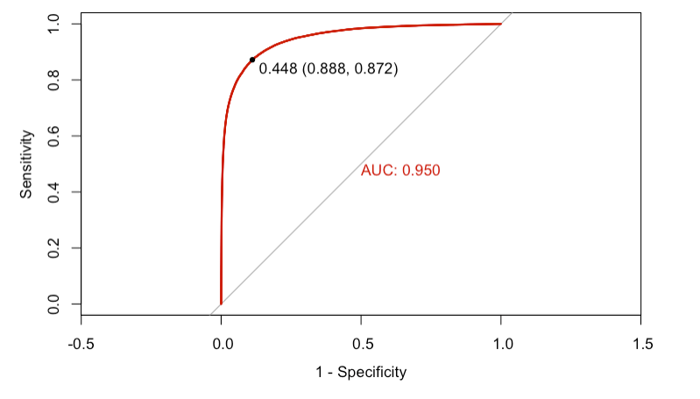
Model Validation

Slide 8
Result Interpreation
Three factors that affect passengers’ satisfaction the most?
Travel_Type_Business travel (14.37 times increase)
Online_boarding_Lv5 (9.78 times increase)
Inflight_service_Lv5 (4.23 times increase)
Three factors that affect passenger’s satisfaction the least?
Ease_of_online_booking_Lv4 (86% decrease)
Ease_of_online_booking_Lv5 (74% decrease)
Seat_comfort_Lv3 (66% decrease)

Slide 9
Result Interpretation
From the proposed model, are there any predictors that are often overlooked by airline companies but end up quite significantly impacting passenger’s satisfaction?
Online boarding, Business travel
From the proposed model, are there any predictors that are often over-emphasized by airline companies but end up not positively impacting passengers’ satisfaction?
Seat comfort, Ease of online-booking

Slide 10
Result Interpretation
What are you recommendations to the airline companies?
Focus on promoting to business travelers and building good online boarding experience.
At the same time, don’t spend too much effort improving seat comfort quality and the ease of online booking.

